Slide 1




DreamSpace
Making your ideal room a reality
MIS 6393.003
Foundations of Digital Product Management
Dr. Vasant Gondhalekar
Team Name: Mavericks
MIS 6393.003
Foundations of Digital Product Management
Dr. Vasant Gondhalekar
Team Name: Mavericks

Slide 2






Our team
Kruthagama Divakar (KXD220014)
Sonali Joshi
(SAJ210004)
Rucha Patel
(RSP220005)
Divij Karwasara (DXK210047)
Sana Najmi
(STN180003)

Slide 3
Market Analysis
As of February 2023 - 1,557,000 new homes were completed in the USA.
In the United States, the home furnishings and decor market was valued at approximately USD 342 billion and is expected to grow at a compound annual rate of 4% every year until 2028.
Online sales of home decor products have been growing rapidly in recent years. In the United States, online sales of furniture and home furnishings reached USD 60.5 billion in 2020, up from USD 49.7 billion in 2019, according to Digital Commerce 360.
Sustainability and eco-friendliness are becoming increasingly important to consumers in the home decor industry. A survey by Deloitte found that 80% of consumers are willing to pay more for sustainable products, and 68% are willing to pay more for products that are environmentally friendly.
The COVID-19 pandemic has had a significant impact on the home decor industry. With more people spending time at home, there has been an increased demand for home office furniture, outdoor living products, and home entertainment systems.

Slide 4



Our Vision
Provide an outstanding user experience that makes interior design simple and gives our customers the freedom to design their ideal living space using sustainable and eco-friendly products
Our Mission
Offer a cutting-edge virtual reality application that enables customers to quickly and easily build and see their ideal space designs.

Slide 5
Product Roadmap
 | Quarter 1 | Quarter 2 | Quarter 3 | Quarter 4
2023 |  |  | ~Room scanning, furniture placement, color schemes, and themes | ~Lighting options ~Predictive modeling – accurate and personalized furniture recommendations
2024 | ~Virtual reality and augmented reality technology ~Smart Suggestions | ~Retailer marketplace and Classifieds – rent or buy ~Home delivery | ~Customer support ~Budget tracking ~Furniture Manufacturing | ~DreamSpace Community ~Share and Consult with experts
2025 | ~Outdoor living spaces and landscape design ~Workplace design | ~Virtual Home Staging ~Event planning and decoration

Slide 6
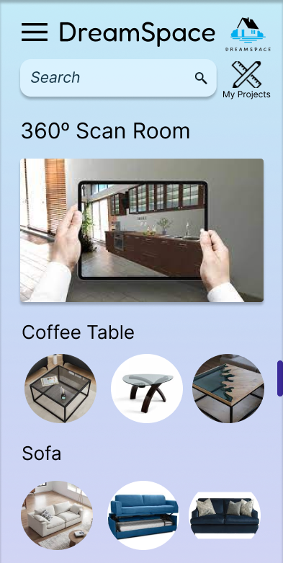
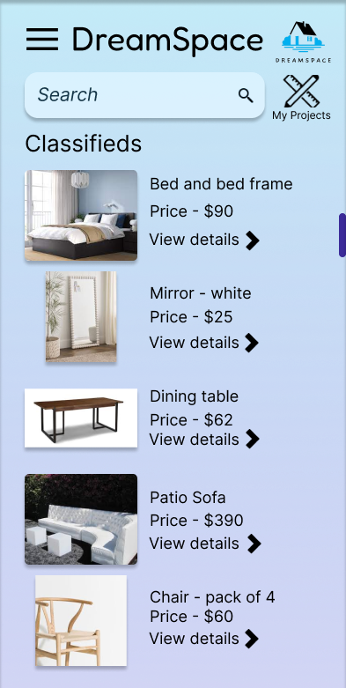
User Interface

Slide 7
Innovation
Technology
LIDAR:
To measure distance and create highly detailed 3D rendering of spaces
Machine Learning:
~Analyze past or similar themes to generate predictive models
~Identify elements and develop design inspiration
Artificial Intelligence:
~Personalize design experience as per room size, color, lighting and client’s requirement
~Suggest materials based on durability, sustainability and budget
~Converse with a chat bot which provides latest trend in interior designing
Virtual Reality:
Enable users to see and customize their dream space using VR headset
DreamSpace Community
Get the latest trends and insights in interior designing
Connect with expert interior designers
Share your work and engage with a worldwide network of self-made designers
Earn Rewards and Loyalty points for your design
Market Place
Find the best deals for items/furniture you wish to incorporate into your design.
Partner with local stores to rent out furniture.
Supply Chain Model for Home Delivery

Slide 8
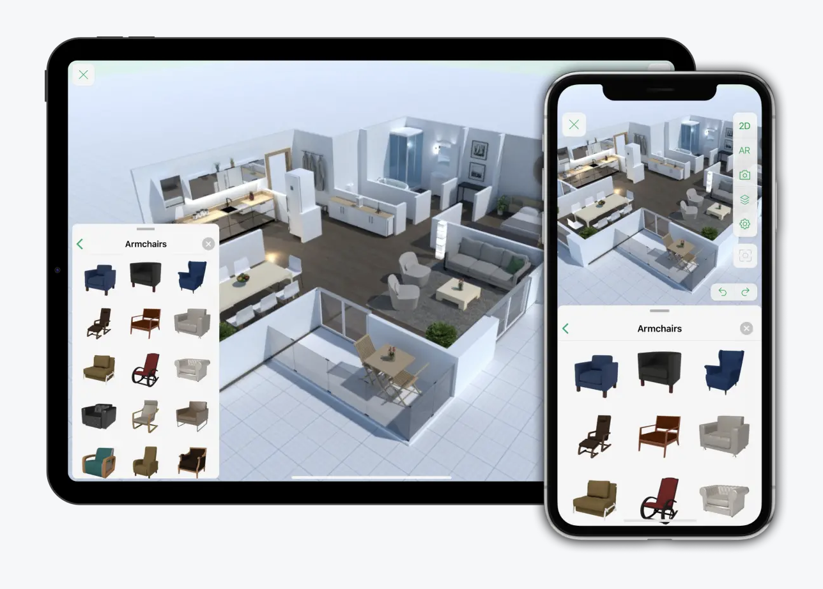
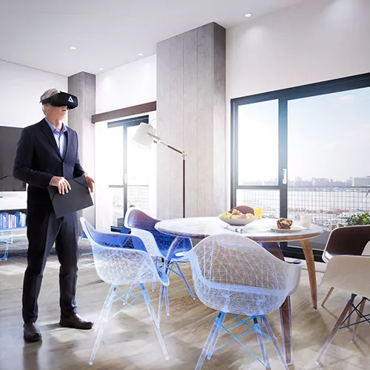
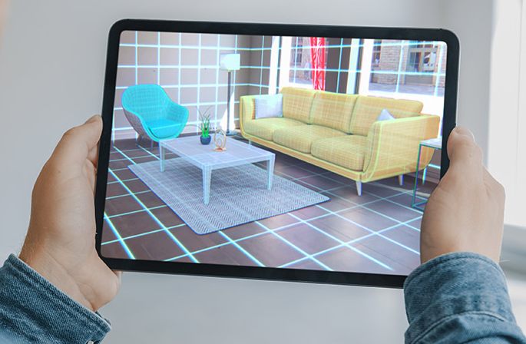
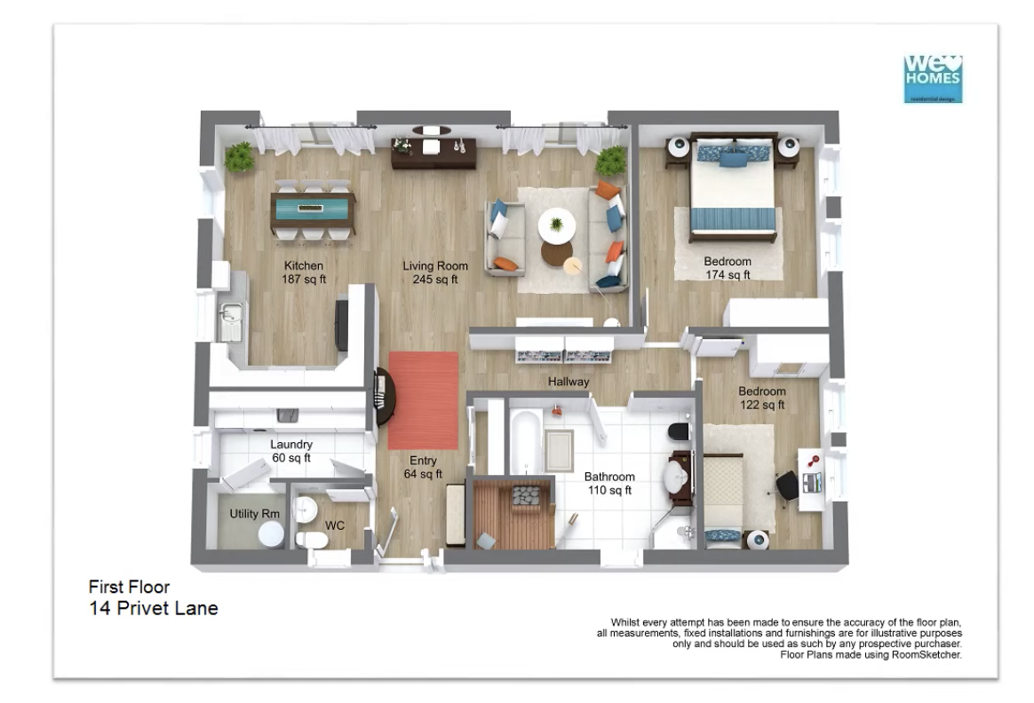
Disruptive Innovation
Real Furniture:
While other virtual design apps offer generic furniture options, DreamSpace stands out by providing access to real furniture that can be found at stores near you.
Virtual and Augmented Reality:
With the assistance of virtual reality tools, users can experience a real-time visualization of how their space will appear and feel.
Notes:
Rent and buy
Virtual reality
Augmented reality
Sustainable and eco-friendly products
Real-world furniture suggestions from retailers
Add comparison with competitors?

Slide 9
Disruptive Innovation
Sustainable and Eco-Friendly Products:
The application advocates for environmentally conscious and sustainable products and design concepts by utilizing them in designs and suggestions
DreamSpace Community
Similar to Pinterest, DreamSpace Community will allow users to discover, share, and save images. The platform can be used for inspiration, project planning, shopping, and discovering new ideas and trends
Furniture Renting:
If you are someone who is in a place for a short time, say a student on an internship, you can actually save a lot by renting furniture
Notes:
Rent and buy
Virtual reality
Augmented reality
Sustainable and eco-friendly products
Real-world furniture suggestions from retailers
Add comparison with competitors?

Slide 10
Stickiness
Budget Tracking
Ability to track the cost of furniture and decor items and stay within a budget
Seasonal Selection
Smart suggestions for themes, festivities, and holidays
Intuitive Gamification
Incorporating game-like features into software such as the VR Experience
Marketplace and Home Delivery
Rent-Buy-Sell and get it delivered to your doorstep
Community
Platform to network with like-minded individuals
Rewards and Loyalty
Coupons or furniture giveaways for users

Slide 11


Value Creation
“Everything Revolving around Sustainable and Eco-Friendly Products”
Users:
Before making any modifications, users may get a clear idea of how their area will look, which can save time and money. Users get to enjoy the benefits of the DreamSpace Community.
Interior designers:
To show the end product to clients, interior designers can use virtual interior design software.
Furniture and decor manufacturers:
By giving them a new platform to display their products, by including their products in the software's database to reach new customers.
Real estate agents:
Agents may show prospective buyers what a property might look like with alternate furnishings and decor by utilizing the application to create virtual staging, which could boost a sale.

Slide 12
Value Creation
Subscription Revenue:
After a 15-day free trail, there are 3 subscription models that will help bring in revenue.
License Purchase and Renewal:
Educational Institutes, design and real estate firms can purchase the fully unlocked version of the software for 2 years at a time.
Advertising fee and Commission:
From Home décor merchants for advertising their catalogues on the application and directing customers to them.
From Marketplace by letting customers buy and sell home décor items.
Secondary Sources:
Due to the virtual reality component of the software, there are chances of collaborations with hardware producers, those that develop VR headsets.
Sell Data on customer shopping and design trends to Home Décor merchants and online platforms.

Slide 13
Market Types
Existing
New
Interior Designing Firms
Educational Institutes
Interested Users
Retail Market for Sustainable and Eco- Friendly Home Décor Products
Virtual Home Staging
Target Advertising

Slide 14
Adjacent Market Types
Furniture Manufacturing – Custom-made furniture on request
Real Estate Classifieds – Ads for home rentals and leasing options
Furniture Rentals – Through community and retailers
Event Planning – Décor for special occasions
Packers & Movers – Logistics support for packing and moving
Tidy Homes Services – Resources and tips for home maintenance
Gamification – Organizing and designing games
Notes:
Yes! And you know what they say about having an infinite amount of people banging on typewriters... They will eventually write Shakespeare?

Slide 15
Marketing Strategies
Content Marketing
Online Advertising
Highlight the software's features, tips and tricks for using the software
Google Ads, Facebook Ads, and Instagram Ads
Online Reviews
Social Media and Influencer Advertising
Encourage satisfied customers to leave positive reviews
Collaborate with influencers, bloggers, and interior designers
Notes:
Online advertising: we are going to run a process of PPC (pay per click ads). Any time you search example, furniture near me, room décor near me

Slide 16
Marketing Strategies
Partnerships
Free Trials
Collaborate with furniture retailers and other industry partners
Offer free trials or demos of the software to let users test out the features
Referral Programs
Trade Shows and Events
Encourage existing users to refer friends and family by offering incentives or rewards
Participate in interior design trade shows and events
Notes:
We really want to interact with our audience through engaging events – trade shows and events are an example. The benefit of this example in particular is that it shows brand presence, personal networking, and retains customers

Slide 17




Sales Business Model
Advertisement-Based Model
Merchandising data at 30% reduces prices to Analytics firms for target marketing
Free Trial Model
15 days with additional ads and no expert consultation
Subscription-Based Model
Premium user access –
@ $7.99 per user/month
$79.99 for an annual subscription (user saves ~$16 a year)
Commission-Based Model
5% from Retailers for showcasing their products
1% from users for classifieds postings.
Notes:
Commision based model – acts as a middle man between the retailer and the users through our app. Whats in it for them? Buying their product directly through their website would just be trial and error of whether you end up liking the product in your space, but with using dreamspace you get to "try it on"

Slide 18
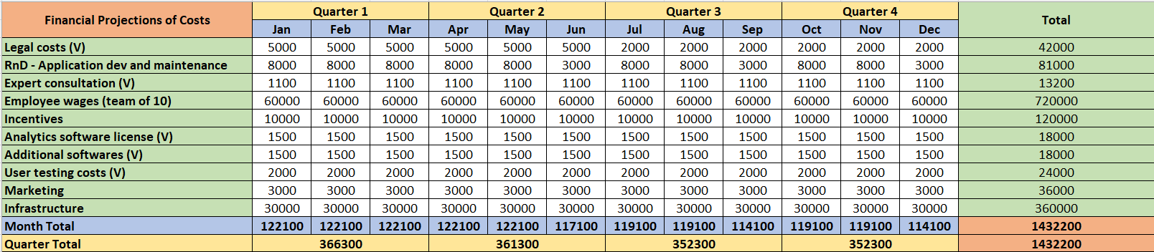
Cost Assumptions
Total estimated cost for the first year – $1.4M
Variable costs (V) can change

Slide 19
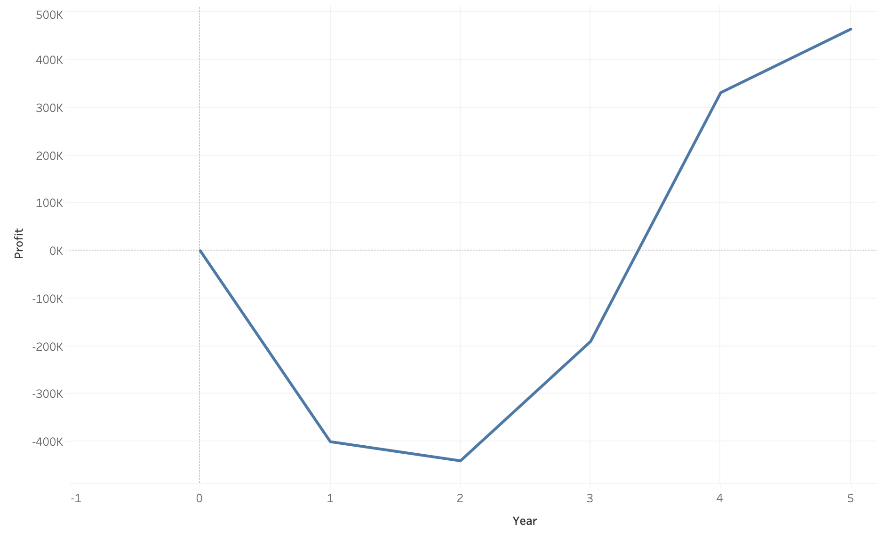
Revenue Generation
Subscription Revenue:
We’ll be targeting 1% of the furniture market that exists, $252B = $2.52B
Per-person expenditure on furniture in a year will be $789.06
We will charge 1% of this for premium services, ~$7.99 / per user
*40% of US population is looking to remodel their living spaces, even if 0.05% of these users use DreamSpace
Our revenue will be $7.998*60,000 = $0.43 M
Advertising Revenue:
The furniture industry spends between 6-8 % on Advertising and Marketing.
0.001% penetration into advertising market will give us($252B * 0.06)*0.001% = $0.45M
Total estimated revenue for the first year – $0.93M

Slide 20

Aftermarket Strategy
Commission Driven
Existing and new partnerships.
Subscription Driven
40% increase in the number of subscribers ever year
Service Driven
Furniture Manufacturing
Furniture Rental
Event Planning
Packers and Movers
Tidy Home services
Advertisements Driven
Continuing social media presence – organic posts
Rewards and referrals
Seasonal selections
Notes:
Service driven: we want to provide all different kinds of services to make the process of creating your dreamspace as easy as possible, our app can connect you to furniture rentals, event planning, packers and movers, and tidy home services

Slide 21
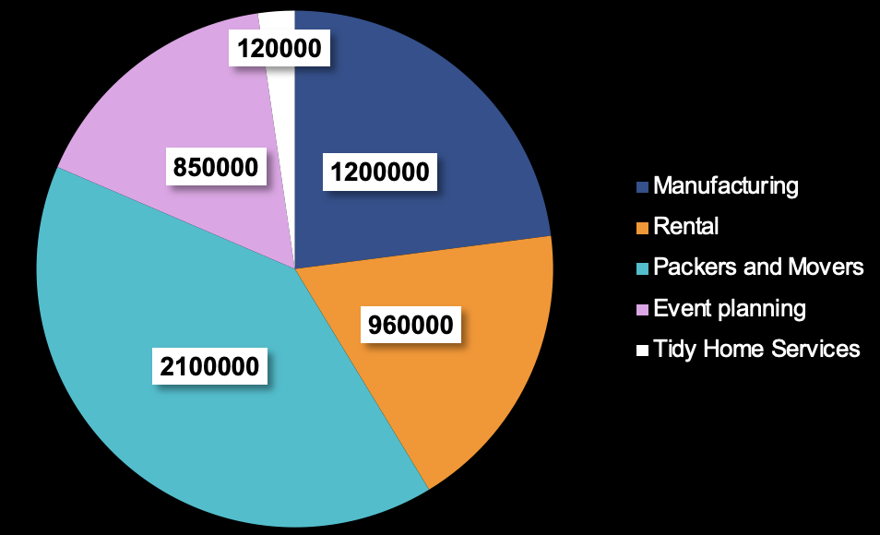
Aftermarket Revenue Generation
Target Revenue for Each Market
Custom Furniture Manufacturing- $120 B
Furniture Rental- $32M
Packers and Movers- $21.7B
Event Planning- $8.5 B
Tidy Home Services- $1.2 B
0.001%
3%
0.01%
0.01%
Total estimated revenue – $5.2 M
0.01%

Slide 22
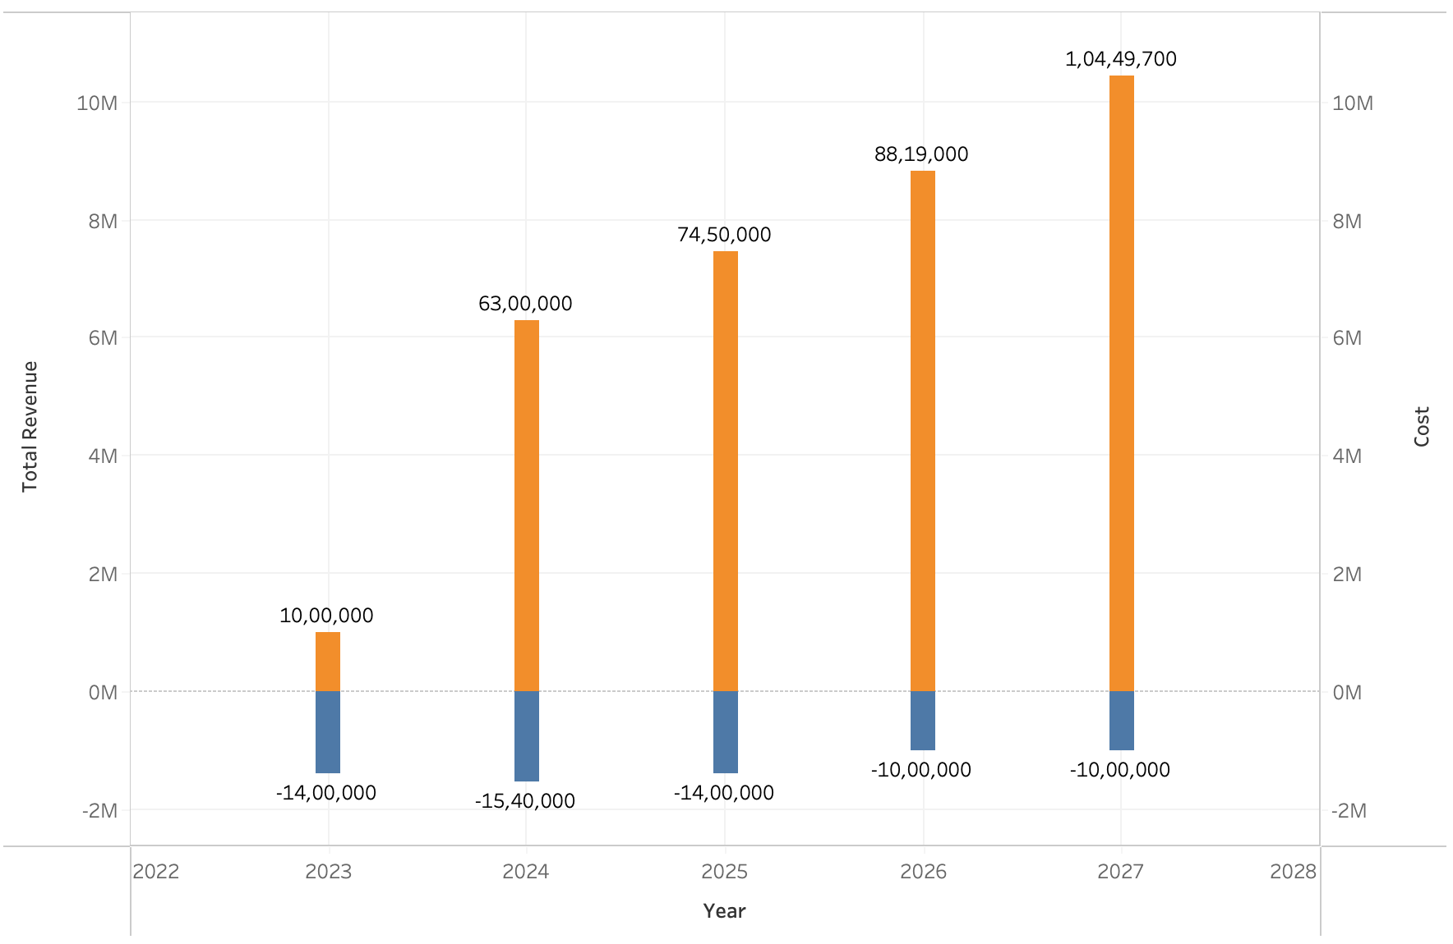
Overall Revenue
Target Revenue of 10M by the end of 2028
Considering a weighted average growth of 15% for our adjacent markets
Minimum operating Cost of $1M after 2025 i.e. after the complete product roll out

Slide 23
Thank You!

Slide 24
References
https://www.statista.com/outlook/cmo/furniture/united-states
https://sensourceinc.com/blog/why-furniture-retailers-measure-store-traffic/#:~:text=Furniture%20retailers%20spend%20on%20average%204.44%25%20of%20revenue%20on%20advertising.
https://www.insivia.com/7-key-marketing-strategies-technology-software-companies/
https://www.statista.com/outlook/cmo/furniture/united-states
https://sensourceinc.com/blog/why-furniture-retailers-measure-store-traffic/#:~:text=Furniture%20retailers%20spend%20on%20average%204.44%25%20of%20revenue%20on%20advertising.
https://www.insivia.com/7-key-marketing-strategies-technology-software-companies/
https://www.ibisworld.com/industry-statistics/employment/interior-designers-united-states/#:~:text=How%20many%20people%20are%20employed,the%20US%20as%20of%202023.
https://people.com/home/over-70-percent-of-americans-are-planning-on-redecorating-their-home-this-year-study-finds/#:~:text=Over%2070%20Percent%20of%20Americans%20Are%20Planning%20on,Home%20This%20Year%2C%20Study%20Finds&text=Seven%20in%2010%20Americans%20are,whole%20new%20level%20in%202021.

